Slide 1
Application Layer ---IPB 11KW LVDC
Ollie.Cai
22/4/2024

Slide 2
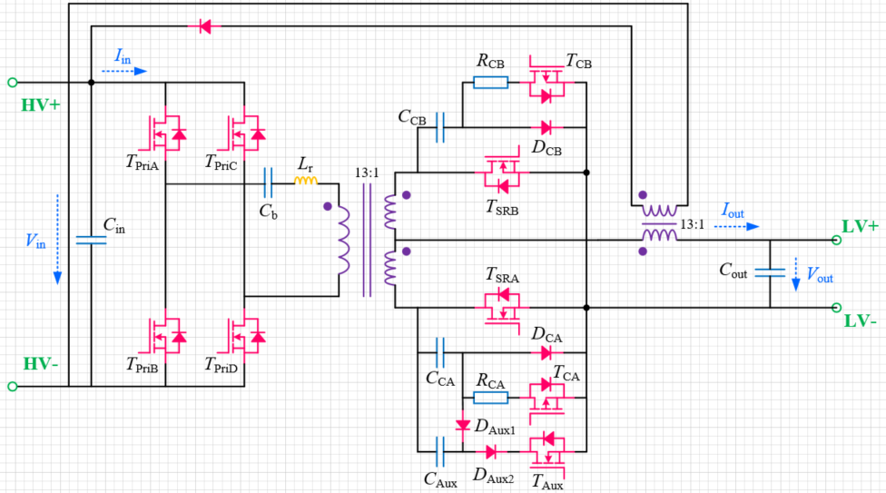
IPB LVDC Introduction
Technical requirements
IPB 3.6kW LVDCDC topology
Vin | 230V ~ 825V
Vout | 6V ~ 15.5V
Iout | 0 ~ 250A (Nominal, without derating) 250A ~ 320A (Peak, without derating) 0 ~ -160A (Precharge)
Pout | 0 ~ 3.6kW (Nominal) 3.6kW ~ 4.1kW (Peak, with 110A·s limit)

Slide 3
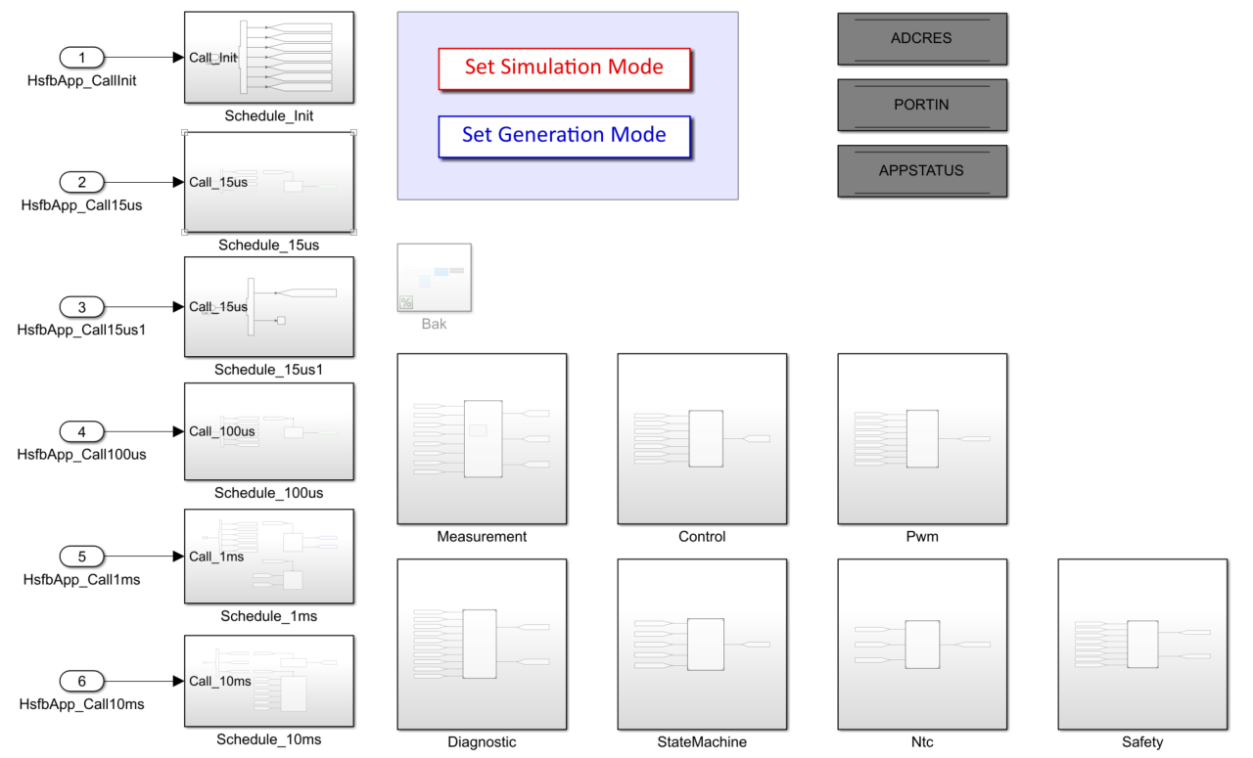
Application layer
The App layer has five periodic schedules with cycle time 30us, 30us,100us, 1ms, 10ms.
The App layer has 7 sub-components which will be called by this component, include HsfbMeas, HsfbCtrl, HsfbPwm, HsfbDiag, HsfbState, HsfbNtc, HsfbSafety.

Slide 4
ISR Schedule
The Call15us schedule 1 include the function call for HsfbMeas and HsfbCtrl, also it will call Read15us function to read ADC register. and calculate the ADC value to real vaule in HsfbMeas module. Also will calculate the control loop in HsfbCtrl module.
The Call15us schedule 2 include the function call for HsfbPwm.
The Call100us schedule include the function call for HsfbMeas, HsfbCtrl, HsfbPwm, HsfbDiag and HsfbSafety, also it will call Read100us function to read ADC register.
The Call1ms schedule include the function call for HsfbMeas, HsfbDiag, HsfbState and HsfbSafety, also it will call Read1ms function to read ADC register and Port register, and call Write1ms function to clear HW error latch.
The Call10ms schedule include the function call for HsfbNtc, also it will call Read10ms function to read RX data from ComServ, and call Write10ms function to write TX data to ComServ. The TX data is include PortStatus1ms, MeasStatus1ms, DiagStatus1ms, StateStatus, NtcStatus and SafetyStatus1ms.

Slide 5
HsfbMeas Module
The HsfbMeas component will convert digital value from ADC Register to real value to and for Control/Diag/Safety module and for CAN communication.
15us : measure variable which are mainly used in control loop.
100us: measure variable which are mainly used in control loop.
1ms: measure variable which are mainly used in diagnostic , calibrate and report to COM.

Slide 6
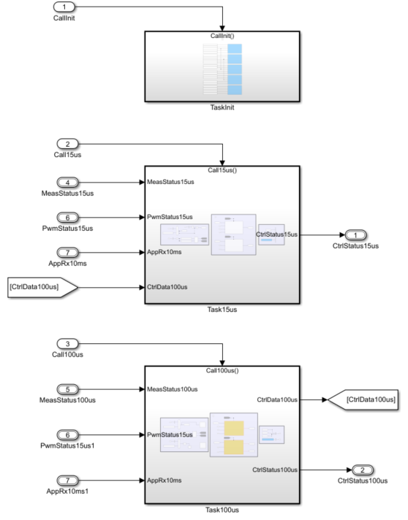
HsfbCtrl Module
The HsfbCtrl component is used to perform voltage and current control for Buck and Boost mode, and calculate output duty for HsfbPwm component.
15us: Used for fast loop calculate.
100us: Used for slow loop calculate.

Slide 7
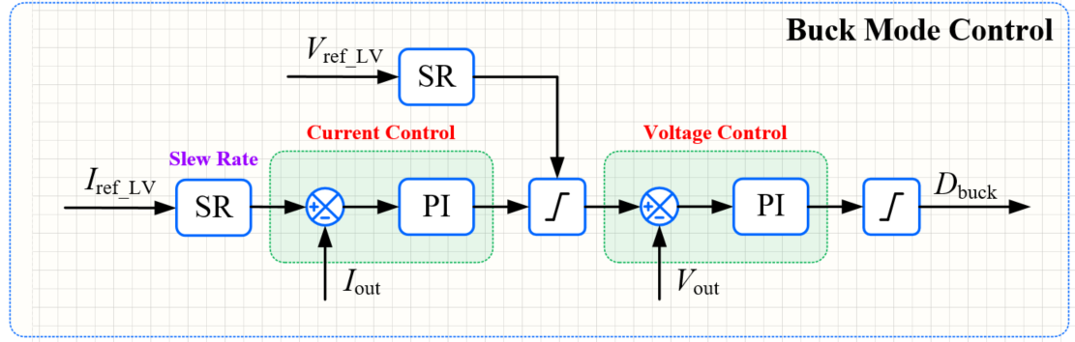
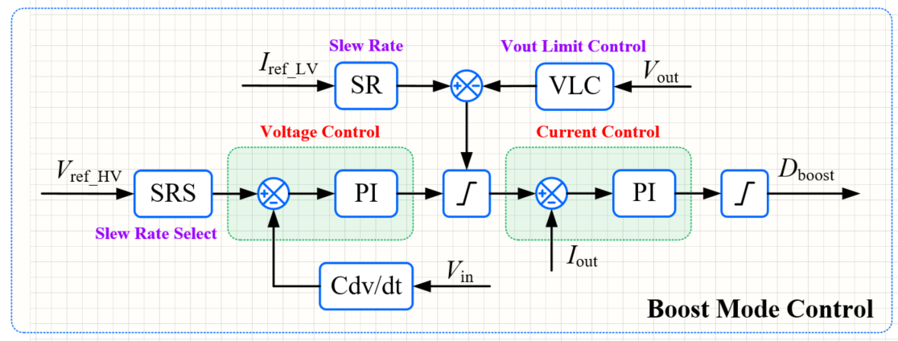
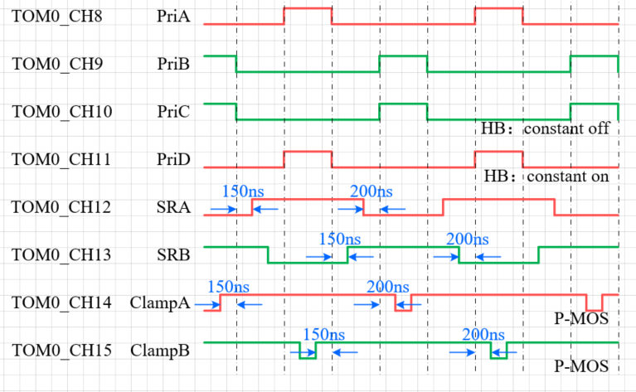
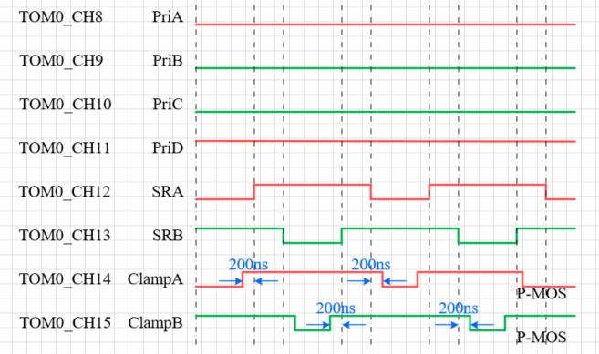
LVDC Control loop and Driver

Slide 8
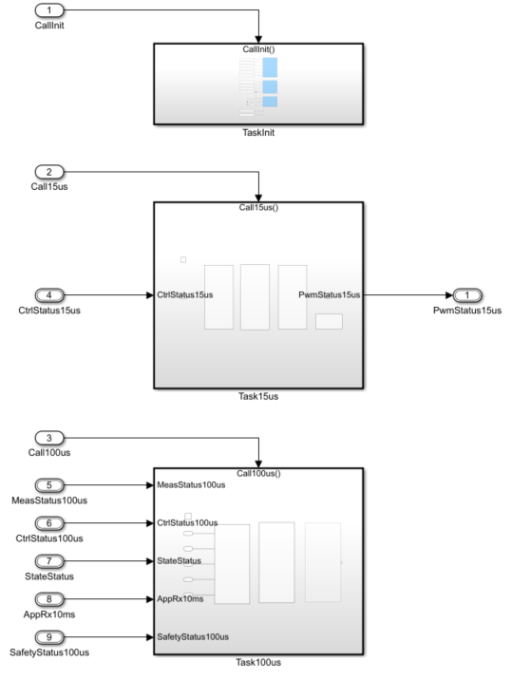
HsfbPwm Module
The HsfbPwm component is used to calculate duty of all the mosfets, control the output enable status, and also perform jitter function and topology morphing function.
15us: Used for calculate duty of all the mosfets and control the output enable status for different mode.
100us: Used for perform jitter function and topology morphing function.

Slide 9
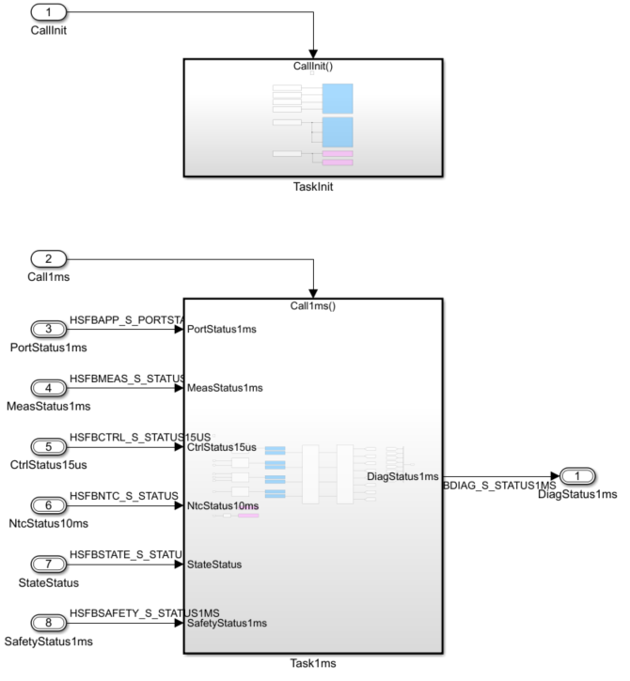
HsfbDiag Module
The HsfbDiag component is used to check all the HW and SW protection, latch the error and generate ErrCode for report and change to Error State.

Slide 10
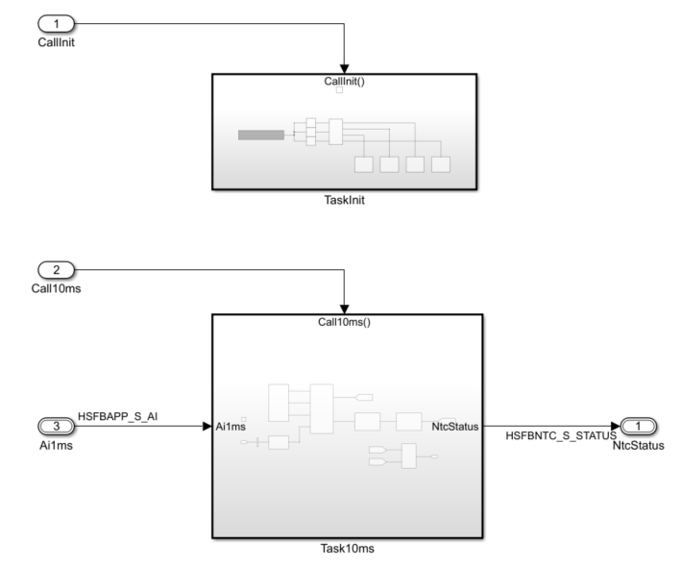
HsfbNtc Module
The HsfbNtc component is used to measure the NTC resistance and calculate the temperature by look-up table method.

Slide 11
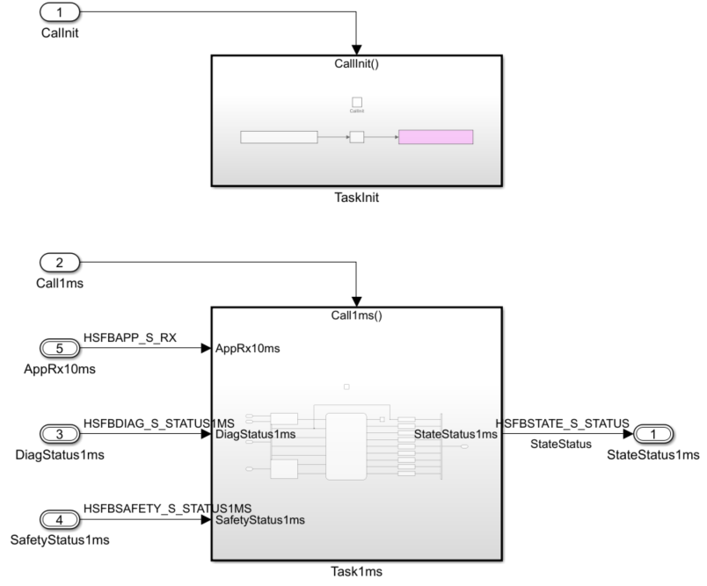
HsfbState Module
The HsfbState component will determine the state of LVDC by command from COM and ErrCode from HsfbDiag, and output the enable, reset and state information for other component.

Slide 12
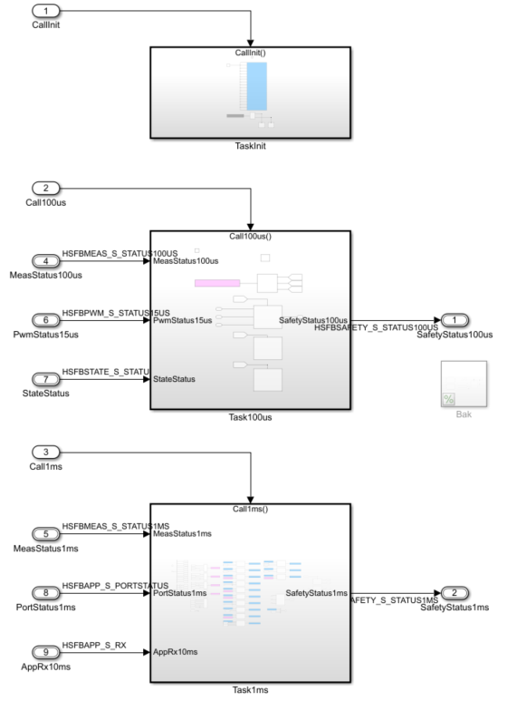
HsfbSafety Module
The HsfbSafety component is used to perform all the safety mechanism which need to turn off the output PWM or report safety status to COM. Also it will run autodiag function after reset, the normal operation will be blocked if autodiag process is not finished.
100us: used for safety check which need turn off PWM in short time
1ms: used for safety check and perform the startup autodiag function.

Slide 13
Smarter. Greener. Together.

Slide 14
Top Level Architecture

